Slide 1


Interactive project development
976860W

Slide 2
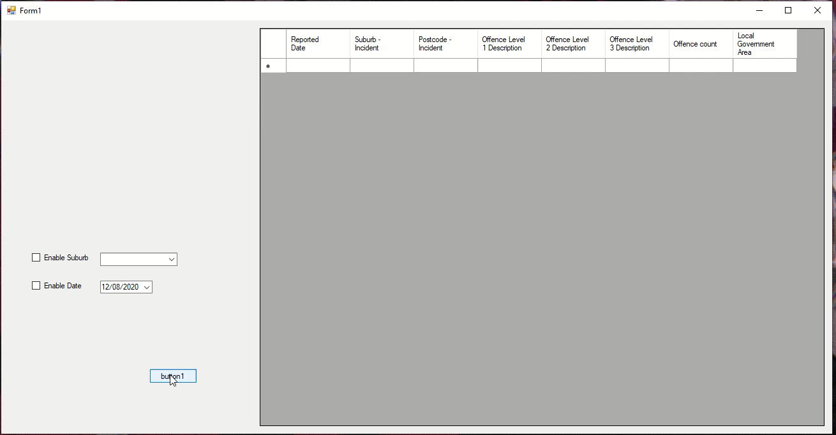
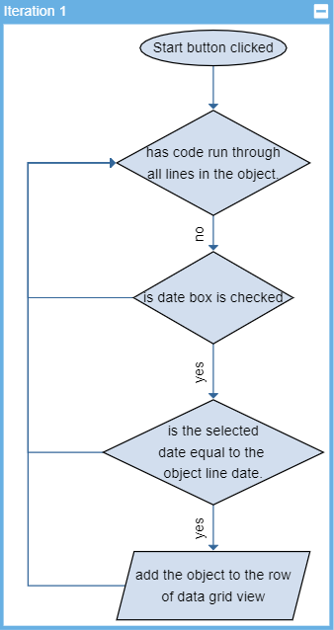
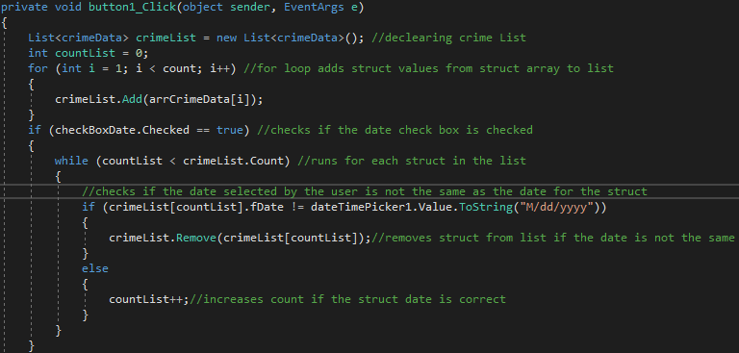
Iteration 1
The first Iteration includes sorting through the data by date.
List is used to sort dates.
Check box enables the sorting of date.
Date time picker allows for the user to select a date and for it to be in correct format.

Slide 3
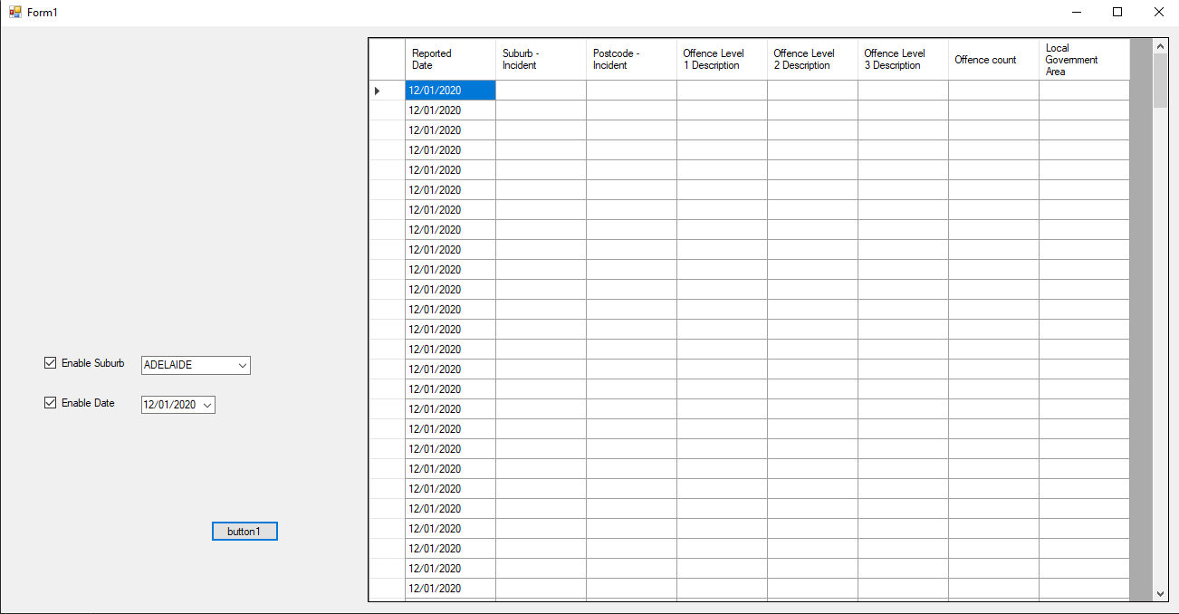
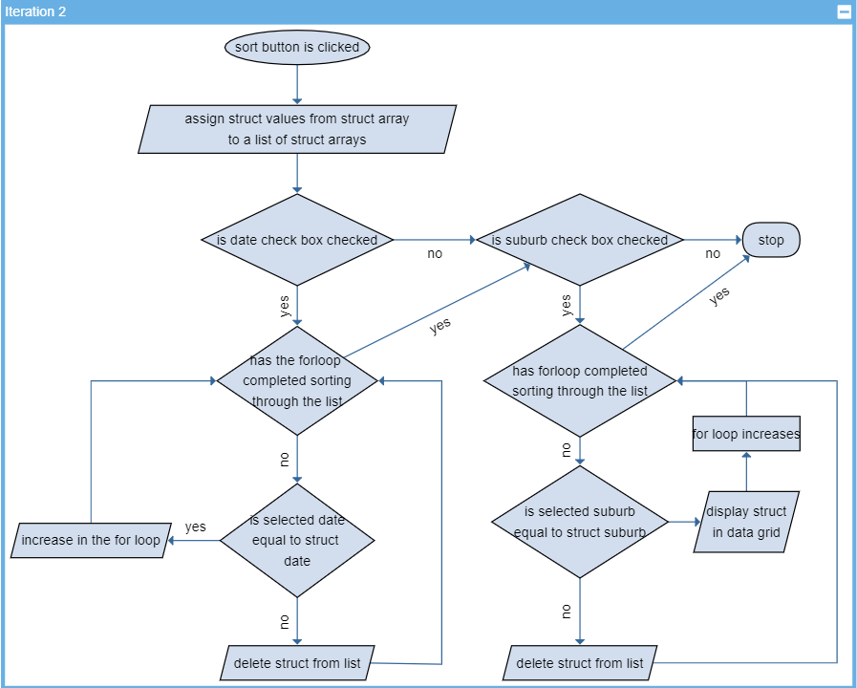
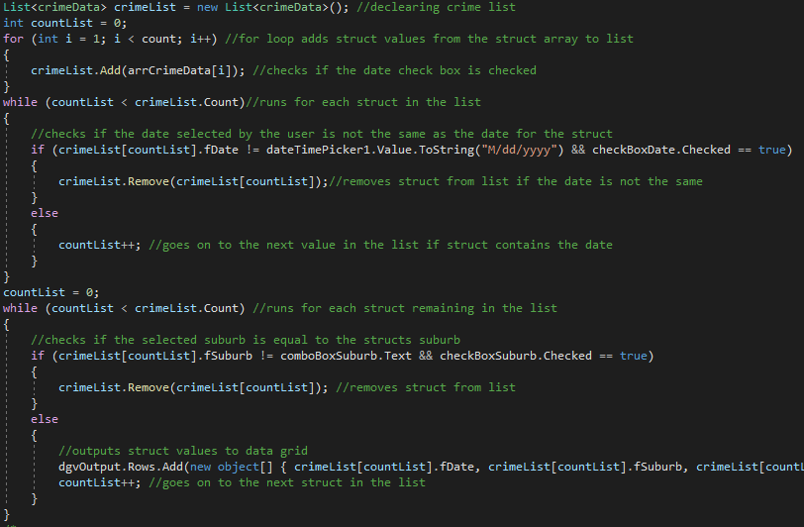
Iteration 2
The suburb filter was found to not work and must be improved on.
If both check boxes were checked, it would remove all structs in the list that don’t have the correct date, then run through the list again removing all structs that have a different suburb.
A combo box is used for the suburb selection.

Slide 4
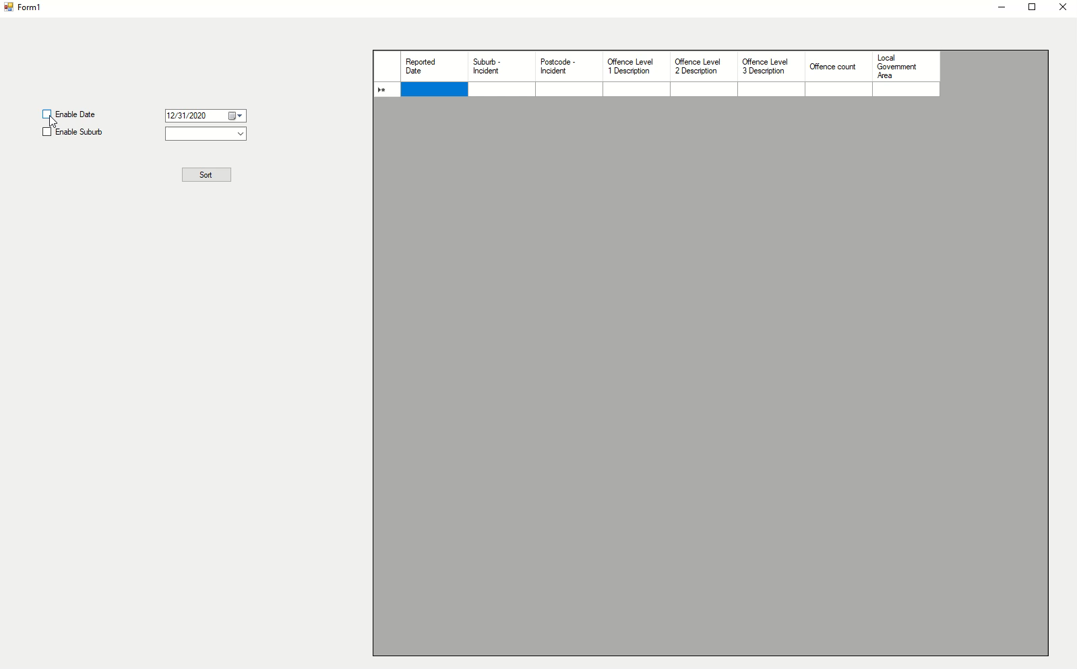
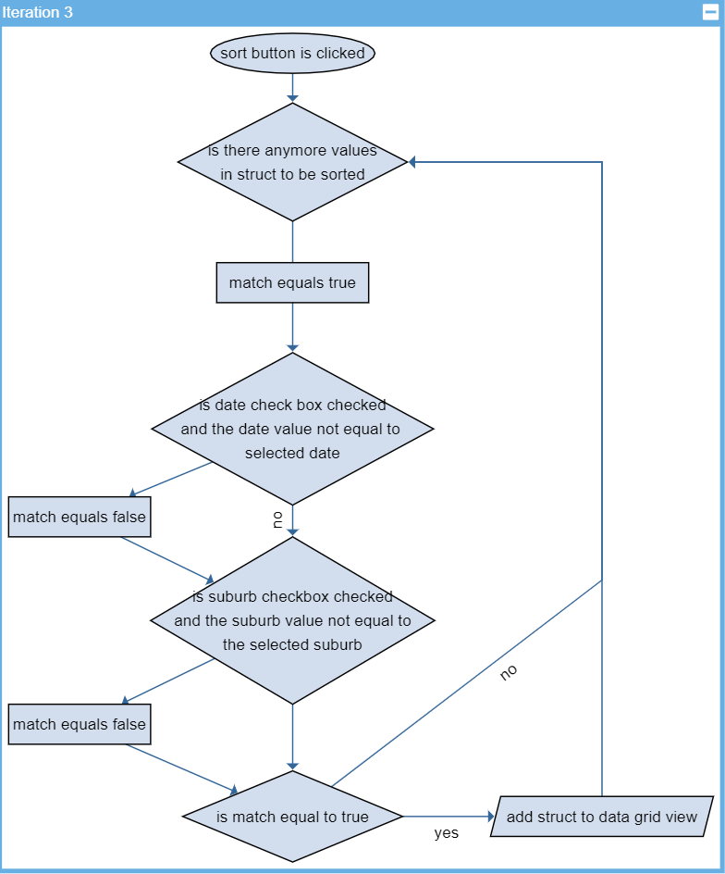
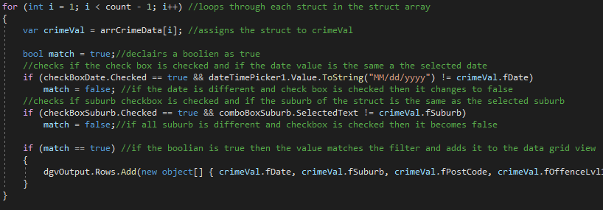
Iteration 3
The code is changed to become easier to add more filters onto and become more efficient.
Code doesn’t use a list anymore, only if statements and a single for loop.

Slide 5
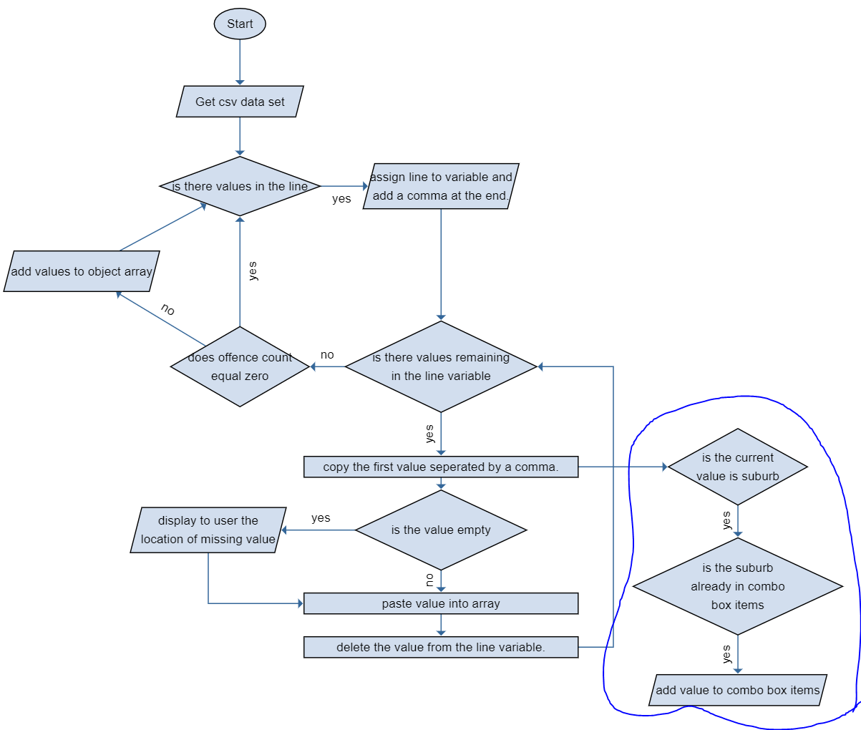
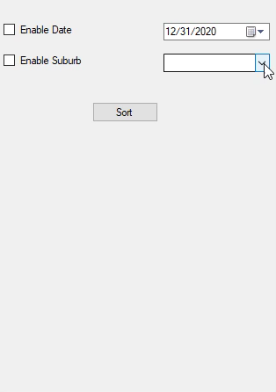
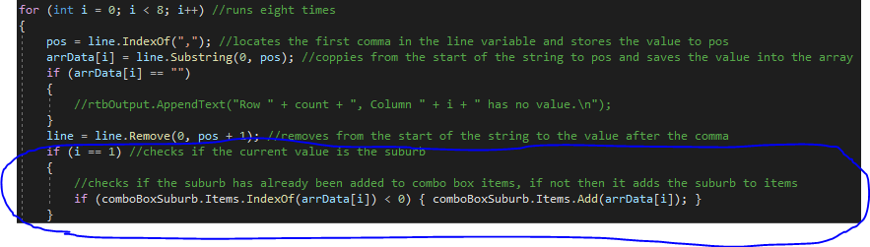
Iteration 4
The combo box now has a drop down of all the suburbs making it easier for the user to select
When typing the name of a suburb it will auto suggest a suburb from the item list by the spelling.

Slide 6
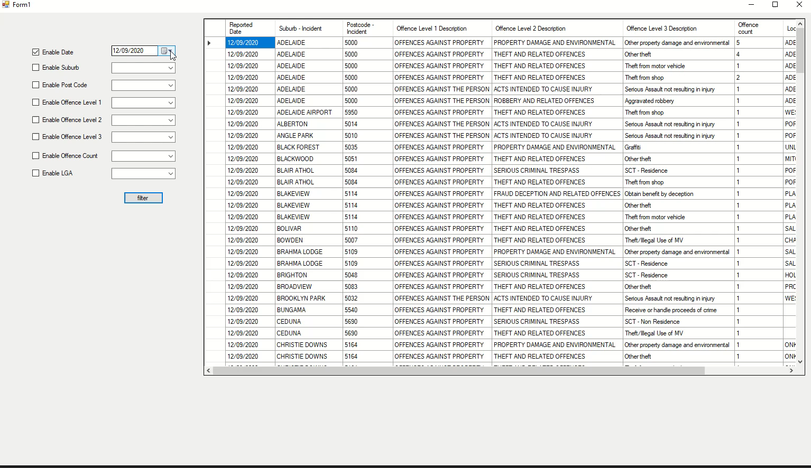
Iteration 5
Consists of all different categories that can be sorted.

